Slide 1


Welcome

Slide 2



Banking system using java
PRESENTED BY:
SUBHRANGSHU CHAUDHURI
SUBHRO DUTTA
SATYABRATA SARKAR
SUKANTA SHARMA
SUBHAJIT GANGULY
UNDER THE GUIDANCE OF:
MR. CHANDAN MUKHERJEE

Slide 3


Introduction
What is banking in our project ?
Banking system in our project refers to the manual data entry-file type system, without the use of the online type, where there are mainly two actors, the OPERATOR & ADMINISTRATOR .
In the bank , here the user provides the information to the operator about the job the user wants and conveys that to the operator.
The operator on behalf of the user fills the necessary tabloid for that application of the user to be processed.
Here in our project is the main player is the ADMIN. The Admin creates an operator who works on behalf of the Admin.

Slide 4


HOW OUR PROJECT IS ADVANTAGEOUS?
The Banking System of our project can be a real handful , as our project completely evades out the manual records , and also on the other hand reduces the dependence on the internet thus reducing costs.
In our system , first an user fills up a form and gives to an appointed operator who can create an account for the user , delete an account , can issue loan , locker , open a savings or a fixed deposit account , also can issue Demand drafts , ATM cards , Cheque book among various other functions .
The Administrator of the bank appoints the various operators of the bank and the Admin has access to all these details apart from the operators , so there are basically two main actors in our project the Admin and the operator .
Some functions such as LOAN or a LOCKER can be issued only after the approval of the Admin and not directly from the Operator.
In every field there is a validation check, for that this project is different from the others.

Slide 5

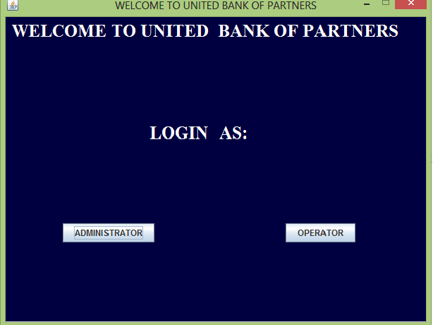


LOGIN PAGE
There are two way to login.
1) Administrator :-
It has all the power what a admin need. Admin can create operator and access all parts of the system.
2) Operator :-
It can control some basic operation in behalf of the customer.

Slide 6

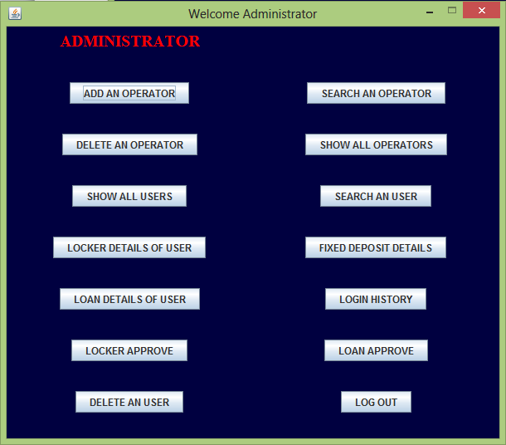


LOGGED IN AS ADMIN
Admin can access all the functions as shown in the picture.
Admin can control the operator as well as user.
Admin can trace every operator when they logged in and when they logged out i.e. the total login history of operator.
Admin has a one more special function in this project that if a customer or user apply for a loan or locker, it can only be approved after admin approve his application

Slide 7

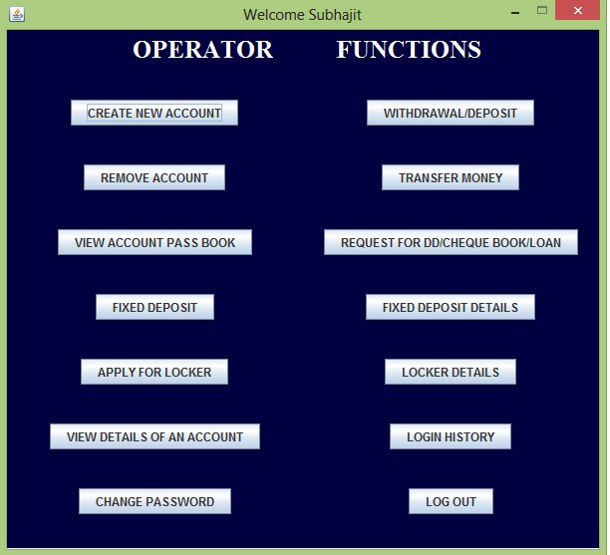
LOGGED IN AS OPERATOR
Operator has basically only one job, i.e. with get in touch to customers or users and serve
Operator can do basic function like create an account, withdraw, deposit, remove an account, transfer money
If any user want to services like issuing ATM card, DD, Cheque book ; operator can directly issue that one without the permission of the admin.
But if the operator wants loan or locker facilities operator can only apply for that on behalf of them only, but loan and locker facilities will not issued until admin give him the approval.

Slide 8

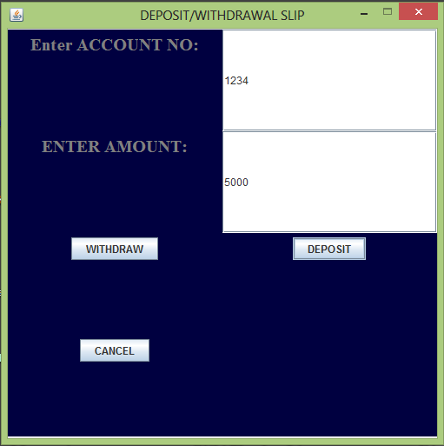
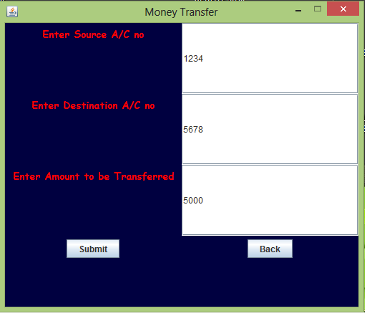
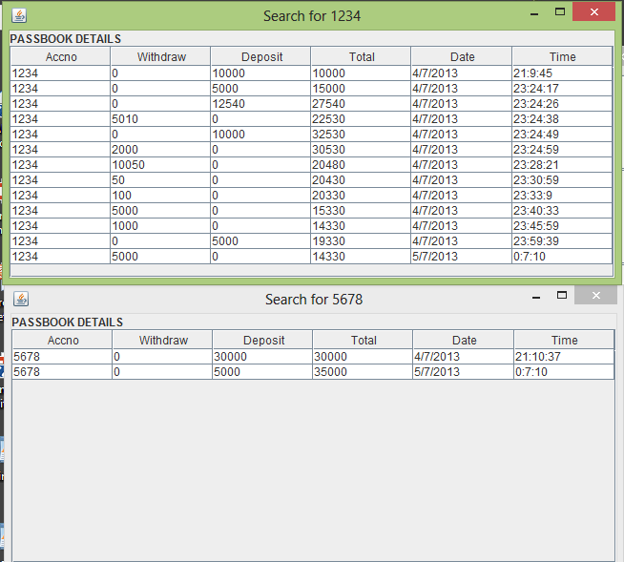
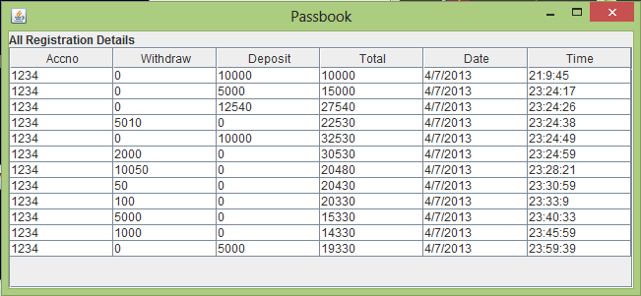

WITHDRAW/DEPOSIT/MONEY TRANSFER
When anyone withdraw, deposit or transfer money it will follow a rule i.e. is the minimum balance after doing the operation should be INR 500.
If the operation successful it will show a conformation message and it will show the corresponding account passbook.
A) Withdraw/ Deposit
B) Money Transfer

Slide 9
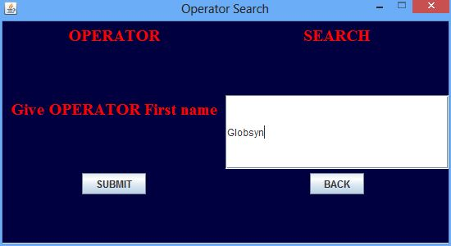
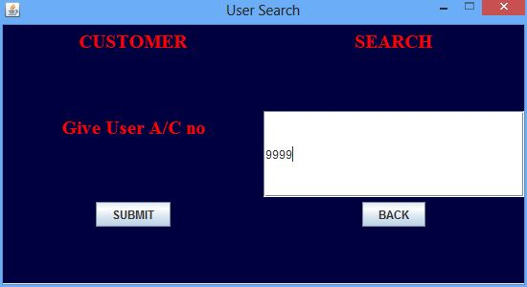
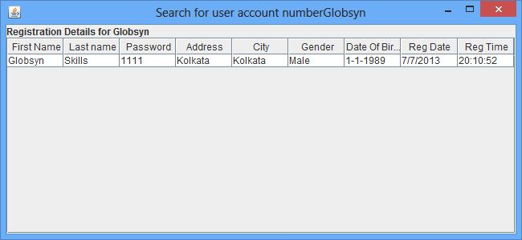
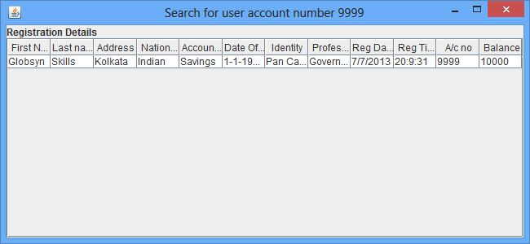
Search an operator/user
When admin searches an operator, operator first name is required for search operation.
When an admin or an operator search a user it have to give its account number.
A) Operator Search
B) User Search

Slide 10

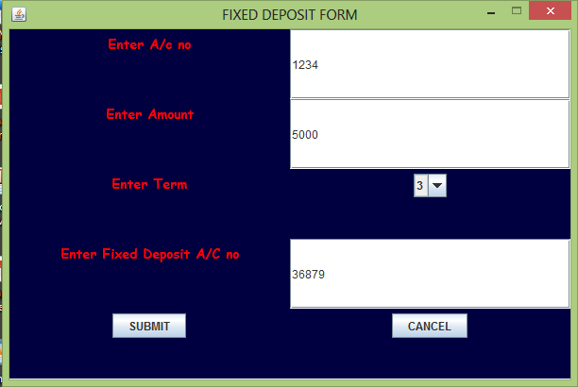
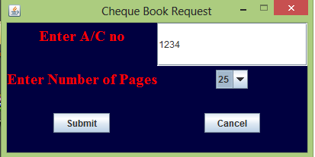
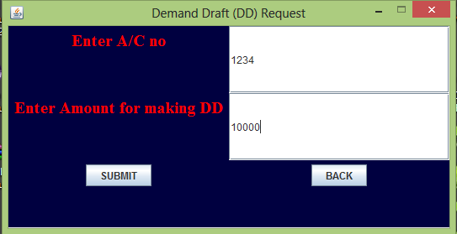
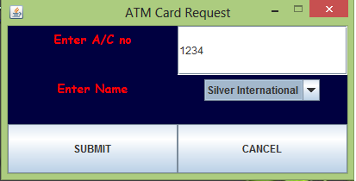
Service Requests which doesn’t need approval
B) Cheque Book Request
A) Fixed Deposit
C) ATM Card Request
D) DD Request

Slide 11
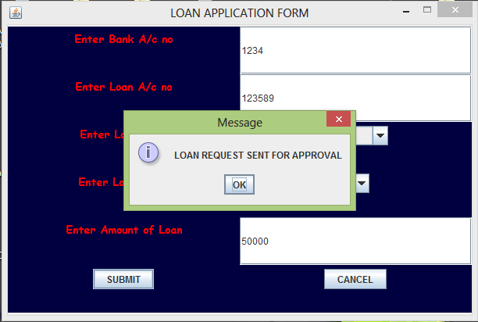
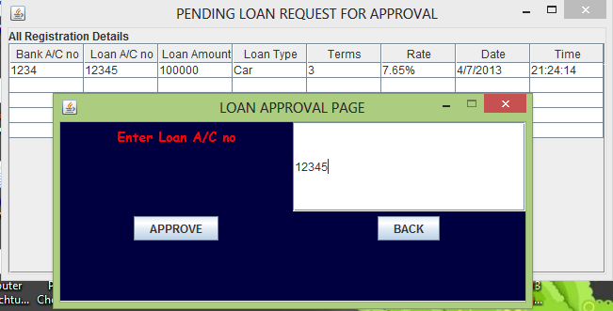
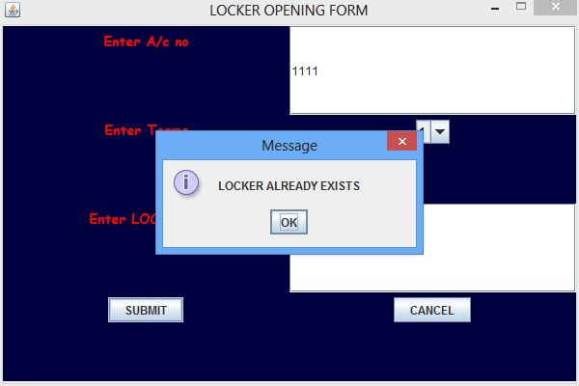
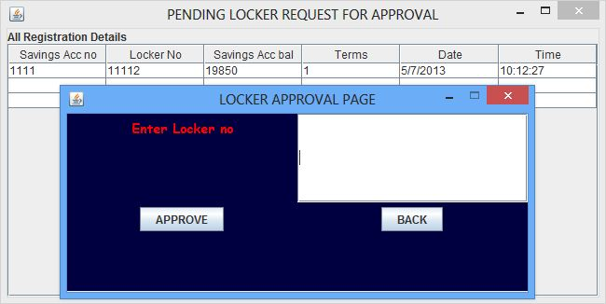
Service Requests which need approval
A) Loan Application From
B) Loan Approve by Admin
C) Locker Application From
D) Locker Approve by Admin

Slide 12

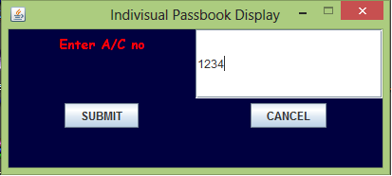
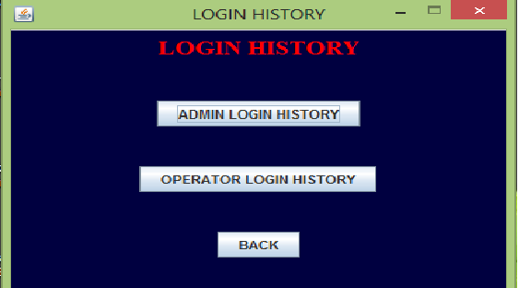
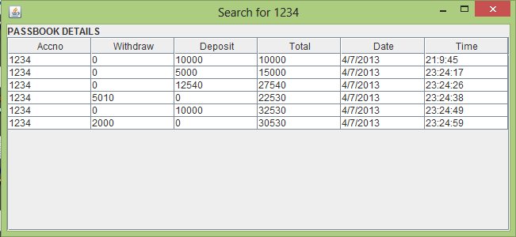
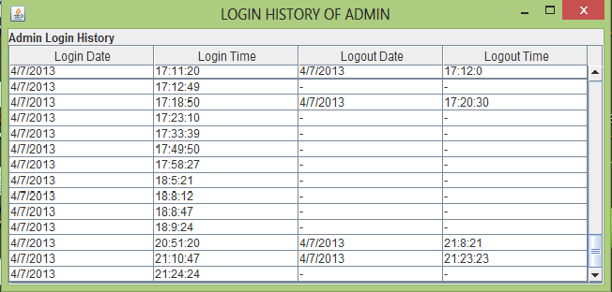

SOME OTHER FACILITIES
F) Passbook for an account
F) Login History

Slide 13


Conclusion
This Banking system have some salient features :-
It has all the things which a standard bank needs.
In this project admin is the main player who can trace and track every movement of the operators, this is very important point to related to services and security.
All customers can have instant service to what they need. The total project is made in a way that a customer can get lightning fast services.
Only loan and locker facilities will be approved after the admin give permission.
The project is very easy to use to the new comers and every one can operate this software very easily with a minimum knowledge of computer.

Slide 14

The End

